Slide 1

Team 24 – Project 1
Customer Shopping Analysis
Data Science Institute - University of Toronto

Slide 2

Team
Shiraz Latif, Jessilynn Kim, Mykhailo Vitvinov, Olena Bolokhonova

Slide 3
Contents
Learnings in this project
Challenges faced
How we overcome those challenges
Future work
What would I add to this project
My Contributions
Strength, I bring to the team

Slide 4
Journey of Learning
Working in a Team
Collaboration & Building Consensus
Framing Business Problem
Project Management
Python programming
Data Analysis
Identifying Trends & Patterns in the data
Exploratory Data Analysis
Regression model development and assessment
kNN classification model
Git & Version control
Working with branches and commits
Pull Request, Approval process
Resolving conflicts in merge

Slide 5
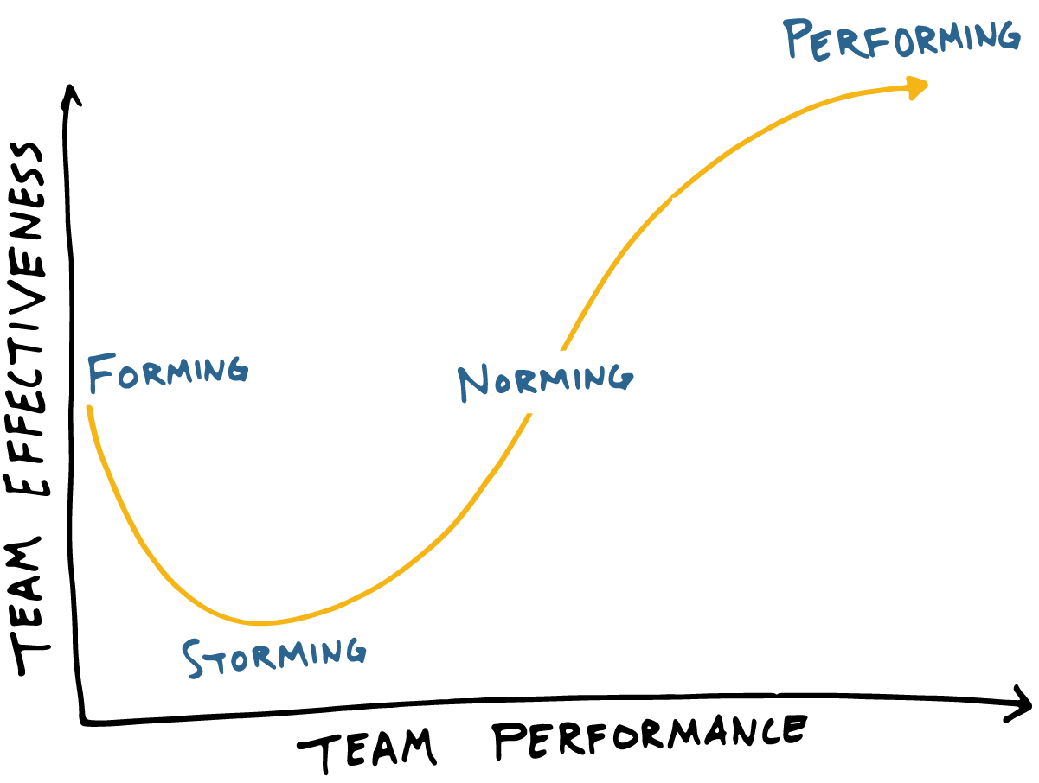


Challenges
First challenge
Working in a new team
Identifying Right Dataset
Over Ambitious Targets
Scope Creep
Time Management
Communication Breakdowns

Slide 6
Issues Resolution
New Team
Respecting everyone’s opinion – Diversity
Strength of each team member was utilized
Identifying Right Dataset
Brainstorming
Collaboration
Discussions
Over Ambitious Targets
Defining Scope
Shortlisting of Questions to address
Scope Creep
Defining and Assigning Tasks
Project Tracker and monitoring
Time Management
Progress update meetings
Flexible schedule
Communication Breakdowns
Whatsapp Channel

Slide 7
Enhancements
MultiRegression
Clustering/ Segmentation Model
Data Enrichment
Exploring more datasources related to retail customers shopping behavior

Slide 8
My Contribution
Every team member contributed at their best
My Strengths
Technical Experience in Business Intelligence
Agile Project Management

Slide 9

Overall Experience

